Slide 1

Investigating Potential Location for Second Headquarter Based on Labour Compensation and Productivity
ZYX Inc.
Group 07:
Alpit Shah; Gagandeep Singh Multani;
Sivanangai Murale; Suher Zaher-Mazawi
June 24, 2019
CSDA 1000 Introduction to Big Data
School of Continuing Education, York University

Slide 2
Contextual Background
Business Context:
ZYX Inc. is a Canadian company and a fast-growing leader in the manufacturing industry
In order to establish global presence and expansion, ZYX Inc. is looking for a second global headquarter (HQ2)
Need to find a country:
  with good track for productivity at work over the span of 30 years, and
  offers value for money spent on pay wages
Stakeholders:
Chief Executive Officer
Senior Management Team
Business Partners
Media

Slide 3
Research Questions
Is there correlation between labour compensation and productivity?
Hypothesis 1: There is a strong positive correlation between labour compensation and productivity. High productive nations have higher labour compensation.
Which continent has high productivity and low labour compensation?
Hypothesis 2: Asia is expected to have high productivity and low labour compensation.
Which country within the high productive continent has optimal level of productivity?
  Hypothesis 3: Japan is the country with the optimal level of productivity in Asia.
Assumptions:
We are aware of social, economic, and political factors that may affect labour compensation and productivity, but we are limiting our analysis to the data we have.

Slide 4
Methodology (1)
Data Sources:
Organisation for Economic Co-operation and Development (OECD)
  international organization
  works with governments, policy makers and citizens, on establishing international norms and finding evidence-based solutions to social, economic and environmental challenges.
  provides a forum and knowledge hub for data and analysis, exchange of experiences, best-practice sharing, and advice on public policies and global standard-setting.
Worldatlas
  educational resource that provides factual information covering topics including geography, sociology, demography, environment, economics, and politics.
  includes charts, tables, lists, graphs and articles.
Datasets:
OECD - Labour compensation per hour worked dataset (.csv file)
OECD - Multi-Factor productivity dataset (.csv file)
Worldatlas - Complete List of Country & Dialing Codes (.html)

Slide 5
Methodology (2)
Data Characteristics:
Structure: aggregated dataset consists of structured data organized in a tabular style of a total 605 rows and 9 columns.
Usage: to answer our business problem, the following 5 data fields with the following labels will be used: Continent; Location; Time; Labour Compensation Value; and Multifactor Productivity Value.
Data Type: (a) Fixed character string; (b) Float
Latency: data collected on an annual bases with high latency (Near Time).
Movement: The data is at rest, stored in an online database platform and includes historical data.
Quality: quality of data collected depends on the quality of national statistics collected from each country and their internal processes. OCED has a quality framework that focuses on improving the quality of data and associated metadata that are collected, processed, analysed, and disseminated.
Security: the dataset has no implications on personal privacy or national security.

Slide 6
Methodology (3)
Variable Types:
Variable Name | Measurement Scale | Data Type | Description
Continent | Nominal | String | Continent name: Asia, Europe, Australia, North America, South America
Location | Nominal | String | 3-Letter international code of a country
Time | Interval | String | Year - measured annually
Labour Compensation Value | Ordinal | Float | Compensation of employees is the sum of gross wages and salaries and employers’ social security contributions. Measured in terms of annual growth rates and indices
Multifactor Productivity Value | Ordinal | Float | Multifactor productivity (MFP) is a type of assessment that is used to measure the level of productivity as it relates to the changes in product output relative to the total inputs involved. This indicator is measured as an index and in annual growth rates.

Slide 7
Limitations
Data limitations
  Labour Productivity data was not available; therefore Multifactor Productivity Data is used.
  We removed all Null values in the Labour Compensation Value and Multifactor Productivity Value columns. This reduced our total rows significantly, and as a result, South America had no countries represented in the clean dataset.
  Only 36 countries are members of the OECD.
Knowledge limitation about labour markets
  In reality, there are various factors like social, economic, and political that may affect labour compensation and productivity, that we are not familiar with.

Slide 8
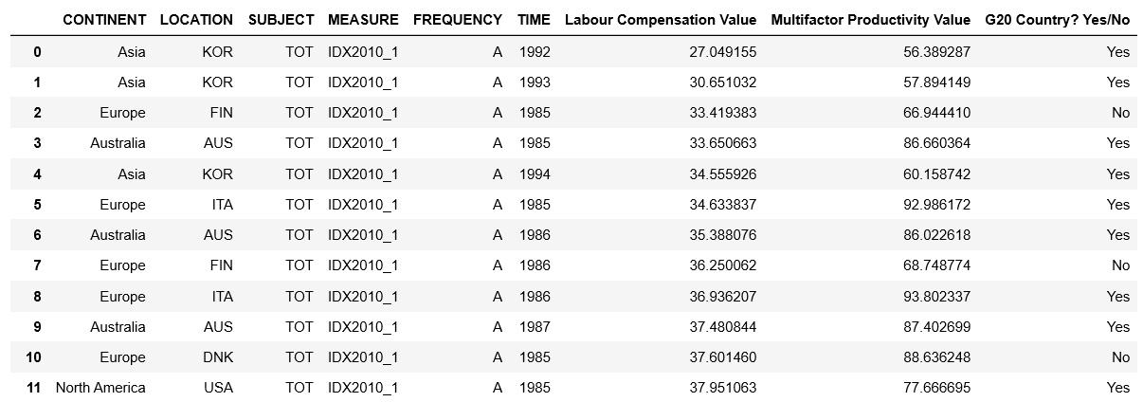
Data Cleaning
Original data set: 1748 rows and 9 columns
Clean data set: 605 rows and 9 columns
Measurement chosen: IDX2010 (Base period 2010)
Time period: 1985 – 2017
Sample rows from the aggregated dataset:
Notes:
Descriptive statistics
Correlation
Scatter plot
Visualization
Scatter plot
Line plot
Bar chart
Dual axis chart
Hypothesis testing

Slide 9
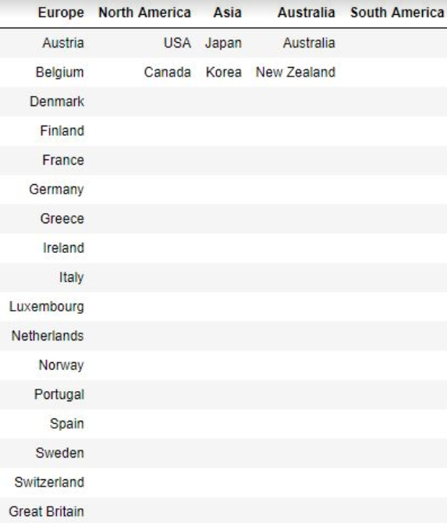
Data Analysis
Countries by continent:
  17 countries in Europe
  2 countries in Asia
  2 countries in Australia
  2 countries in North America
  0 countries in South America
Notes:
Descriptive statistics
Correlation
Scatter plot
Visualization
Scatter plot
Line plot
Bar chart
Dual axis chart
Hypothesis testing

Slide 10
Testing Hypothesis 1
Is there correlation between labour compensation and productivity?
Hypothesis 1: There is a strong positive correlation between labour compensation and productivity. High productive nations have higher labour compensation.
Notes:
Descriptive statistics
Correlation
Scatter plot
Visualization
Scatter plot
Line plot
Bar chart
Dual axis chart
Hypothesis testing

Slide 11
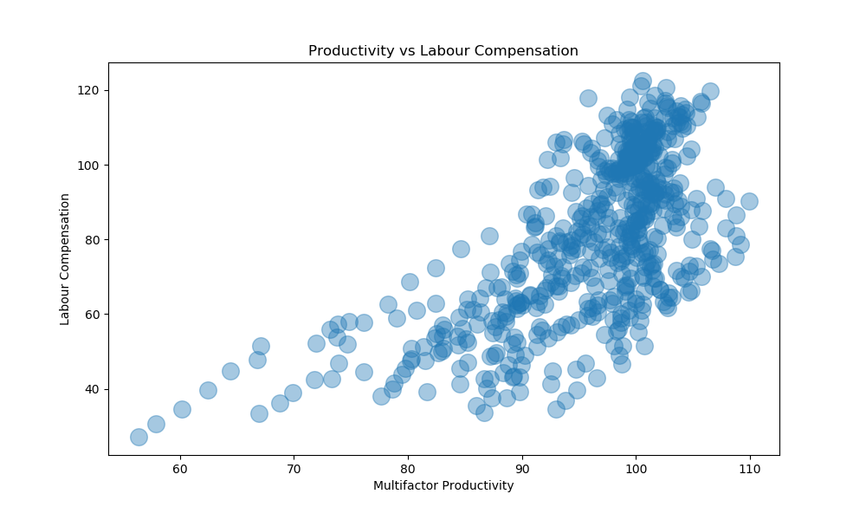
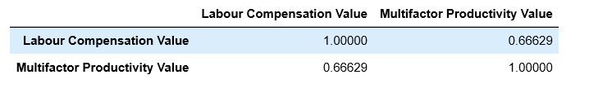
Testing Hypothesis 1
Hypothesis 1 – Accepted.
Positive relationship between labour compensation and productivity.
The higher the labour compensation , the higher the multifactor productivity.
Strong correlation of 0.67
Notes:
Descriptive statistics
Correlation
Scatter plot
Visualization
Scatter plot
Line plot
Bar chart
Dual axis chart
Hypothesis testing

Slide 12
Testing Hypotheses 2 and 3
Which continent has high productivity and low labour compensation?
Hypothesis 2: Asia is expected to have high productivity and low labour compensation.
Which country within the high productive continent has optimal level of productivity?
  Hypothesis 3: Japan is the country with the optimal level of productivity in Asia.
Notes:
Descriptive statistics
Correlation
Scatter plot
Visualization
Scatter plot
Line plot
Bar chart
Dual axis chart
Hypothesis testing

Slide 13
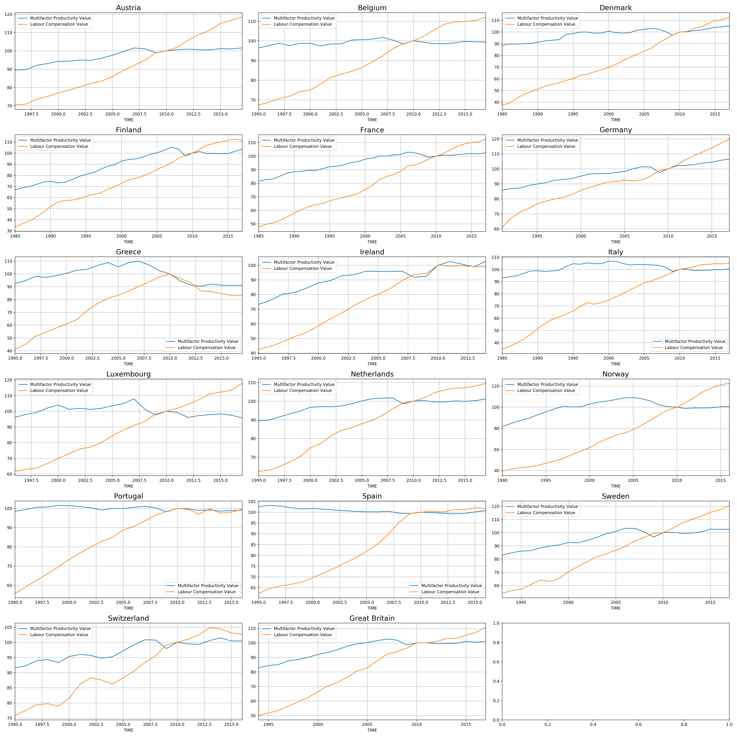
Testing Hypotheses 2 and 3
Step 1: Identify one country within each continent with the most optimal relationship between labour compensation and productivity
Notes:
Descriptive statistics
Correlation
Scatter plot
Visualization
Scatter plot
Line plot
Bar chart
Dual axis chart
Hypothesis testing

Slide 14
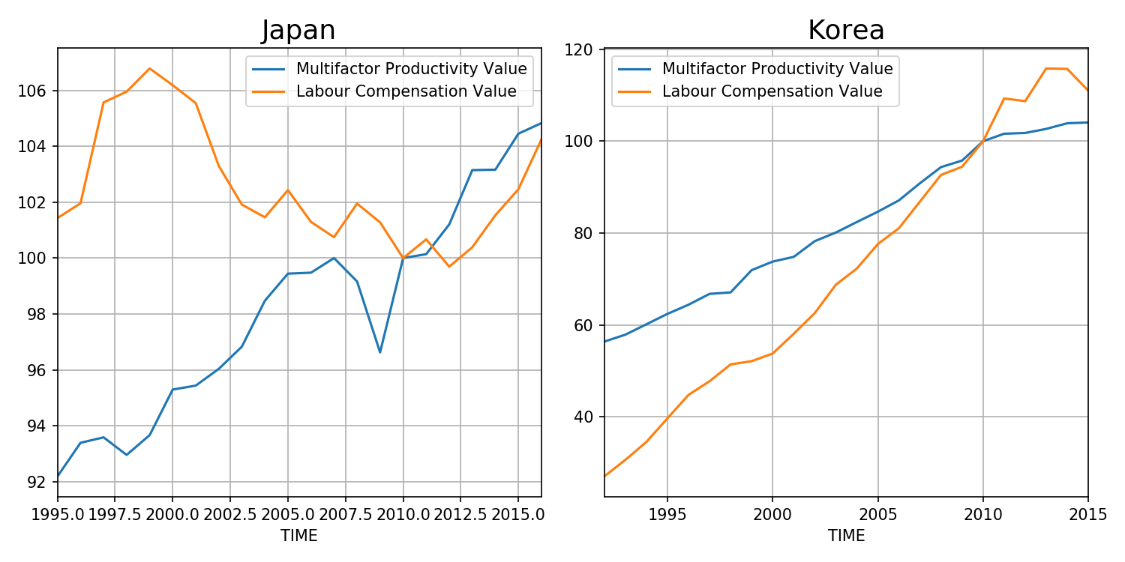
Testing Hypotheses 2 and 3
Step 2: Identify one country within Asia, Australia, and North America with the most optimal relationship between labour compensation and productivity
Productivity and labour compensation from 1985 to 2017 in two countries in Asia
Notes:
Descriptive statistics
Correlation
Scatter plot
Visualization
Scatter plot
Line plot
Bar chart
Dual axis chart
Hypothesis testing

Slide 15
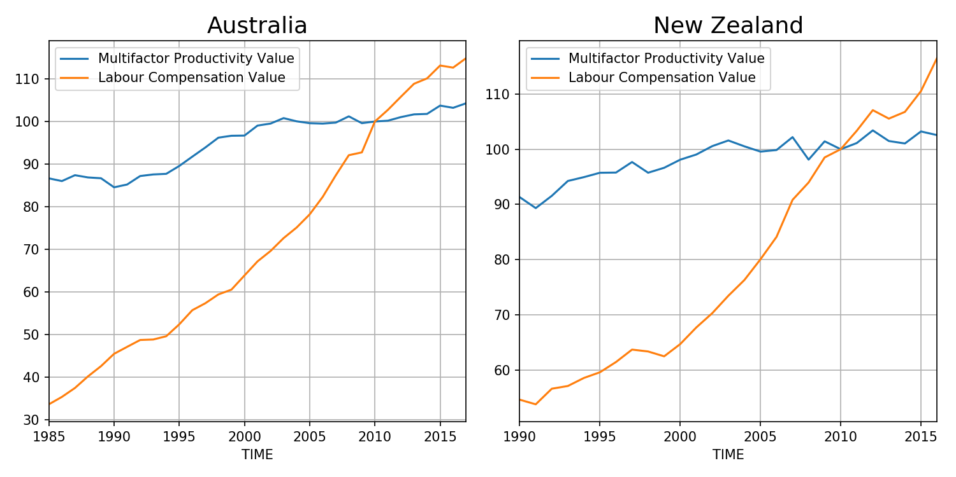
Testing Hypotheses 2 and 3
Productivity and labour compensation from 1985 to 2017 in two Countries in Australia
Notes:
Descriptive statistics
Correlation
Scatter plot
Visualization
Scatter plot
Line plot
Bar chart
Dual axis chart
Hypothesis testing

Slide 16
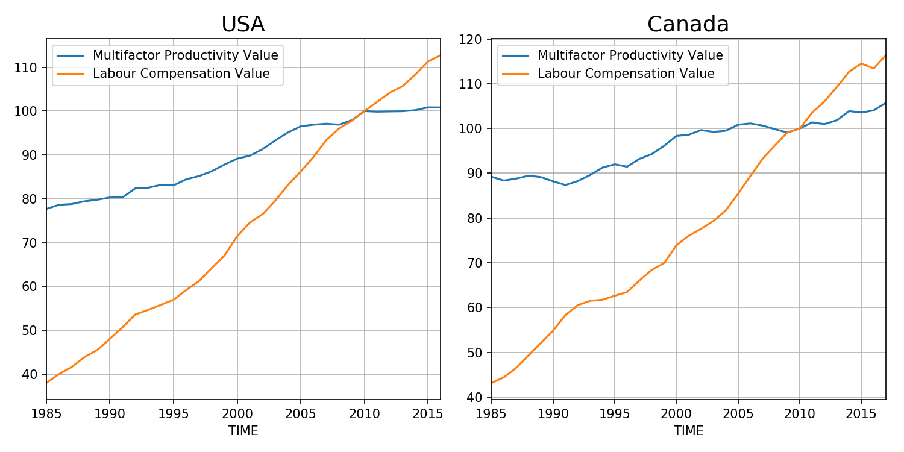
Testing Hypotheses 2 and 3
Productivity and labour compensation from 1985 to 2017 in two countries in North America
Notes:
Descriptive statistics
Correlation
Scatter plot
Visualization
Scatter plot
Line plot
Bar chart
Dual axis chart
Hypothesis testing

Slide 17
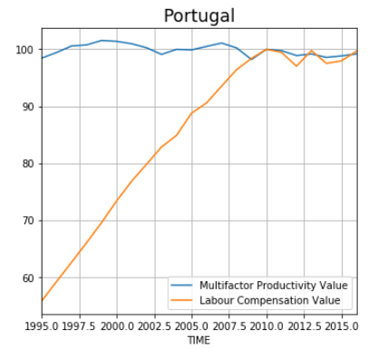
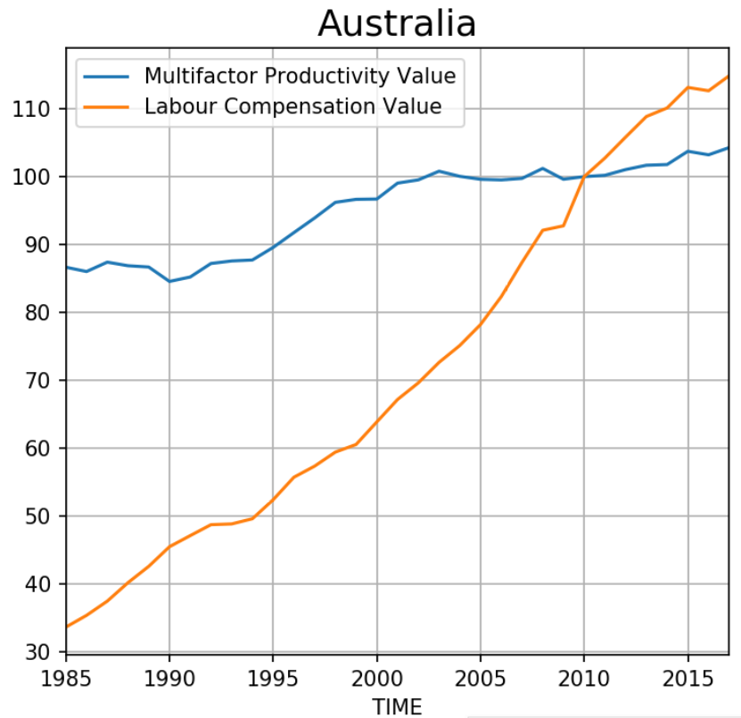
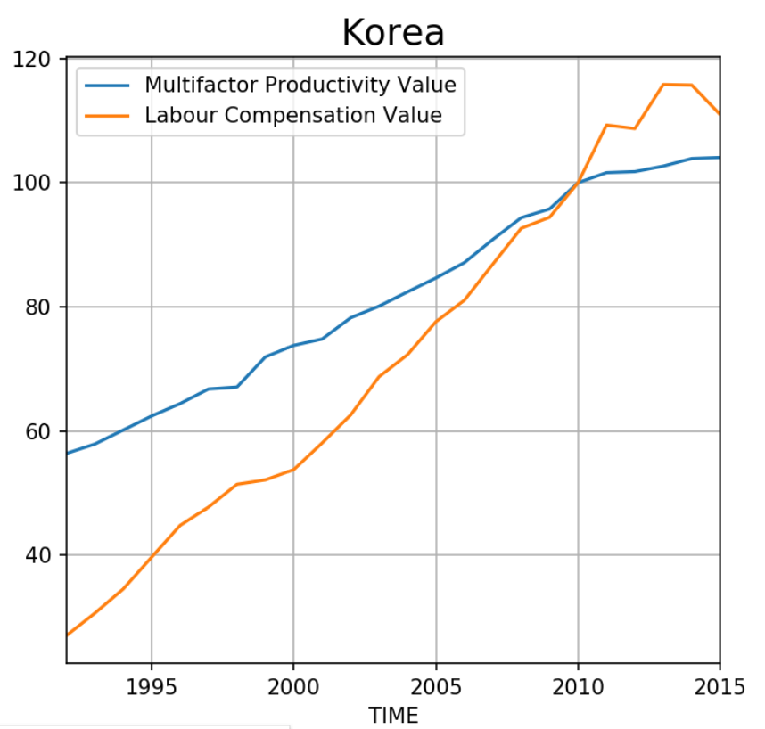
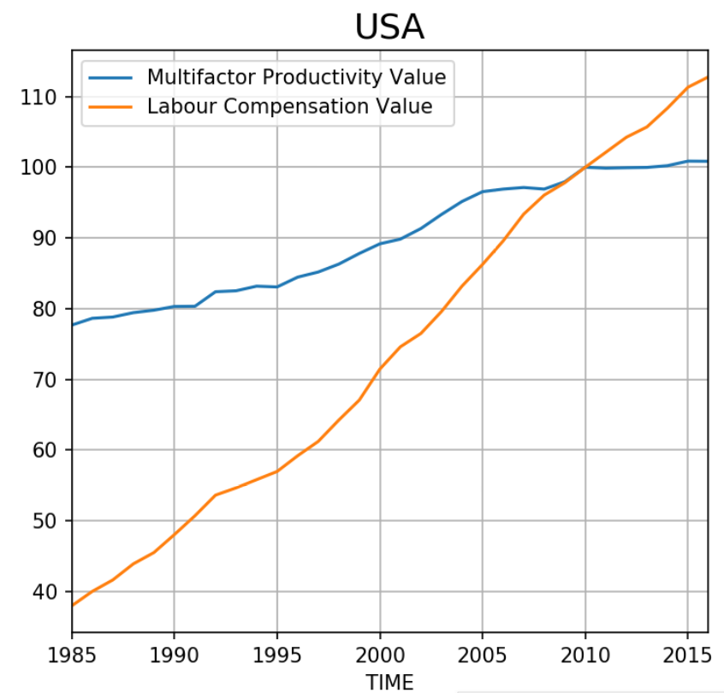
Testing Hypotheses 2 and 3
Step 2: Compare labour compensation and productivity within the continents.
Europe
Australia
Asia
N. America
Notes:
Descriptive statistics
Correlation
Scatter plot
Visualization
Scatter plot
Line plot
Bar chart
Dual axis chart
Hypothesis testing

Slide 18
Testing Hypotheses 2 and 3
Hypothesis 2: Asia is expected to have high productivity and low labour compensation.
Hypothesis 3: Japan is the country with the optimal level of productivity in Asia.
Hypothesis 2 – Rejected.
Hypothesis 3 – Rejected.
In Europe, we found consistent productivity over the last 20 years compared to Asia.
Within Asia, we found that Korea is more optimal than Japan.
Last 5 years shows a trend in higher compensation in Asia versus productivity.
In Europe, there is more stability and low-risk in Europe versus Asia.
Europe
Asia
Notes:
Descriptive statistics
Correlation
Scatter plot
Visualization
Scatter plot
Line plot
Bar chart
Dual axis chart
Hypothesis testing

Slide 19

Conclusion
Portugal (Europe) is the country that meets the following organization’s requirements:
  A country with good track for productivity at work over the span of 30 years, and
  A country that offers value for money spent on pay wages
  A country that provided low-risk and stability for the last 20 years
Portugal is the recommended country
for ZYX Inc. second global headquarter.
Notes:
Descriptive statistics
Correlation
Scatter plot
Visualization
Scatter plot
Line plot
Bar chart
Dual axis chart
Hypothesis testing

Slide 20
Bibliography
“This is where people work the longest – and shortest – hours”. World Economic Forum (March 12, 2019). Available from <https://www.weforum.org/agenda/2019/03/where-people-work-longest-and-shortest-hours/>. Last accessed June 9, 2019.
“Productivity: What Is It? How Is It Measured?”. Statistics Canada (September 2014). Available from <https://www150.statcan.gc.ca/n1/pub/15-206-x/15-206-x2014038-eng.htm >. Last accessed June 9,2019.
“Labour compensation per hour worked, Multifactor Productivity”. OECD (2019). <https://www.oecd-ilibrary.org/employment/data/oecd-productivity-statistics/gdp-per-capita-and-productivity-growth_data-00685-en >. Last accessed June 16, 2019.
“Quality Framework for OECD Statistical Activities”. OECD (2019). <https://www.oecd.org/sdd/qualityframeworkforoecdstatisticalactivities.htm>. Last accessed June 16, 2019.
“For country 3-letter abbreviations”. Worlatlas (2019). <https://www.worldatlas.com/aatlas/ctycodes.htm>. Last accessed June 16, 2019.
“For classifying by continent”. Worlatlas (2019). <https://tradingeconomics.com/countries>. Last accessed June 16, 2019.
Images:
  “Portugal Flag”. Flicker Creative Common < https://www.flickr.com/creativecommons/ >. Last accessed June 23, 2019.
  “Labour reforms are still pending. In their absence, formal enterprises lean on contractual workers”. Illustration: Jayachandran/Mint Live Mint. Copyright © HT Media Limited. < https://images.livemint.com/rf/Image-621x414/LiveMint/Period2/2018/06/11/Photos/Processed/w-edit.jpg >. Last accessed June 23, 2019.

